Slide 1
DATS 6103 Individual Project 2
Analyzing Obesity across USA
By Srilatha Lakka

Slide 2
Purpose
Learn about Data Mining
Learn to extract information from raw data using Python

Slide 3
Dataset
Data was downloaded from Centers for Disease Control and Prevention
Link for the dataset : https://chronicdata.cdc.gov/

Slide 4
Data cleaning and Preprocessing
Data was in excel document with 32 columns
Used dropna() to drop all rows that have any NaN values, not required.
Used rename, groupby, pivot and concatenation of 2 columns
Used python functions to select data for presenting different flavors of analysis.
Following series of analysis was performed to find the highest obesity percentage
Map US Obesity Percentage by state for the Year 2017
Top 10 States for the Year 2017
Top 10 by Gender, Ethnicity & Education
Top 10 by Age Group for the Year 2011 – 2017
Top 10 Total Obesity Rate by State for the Year 2017

Slide 5
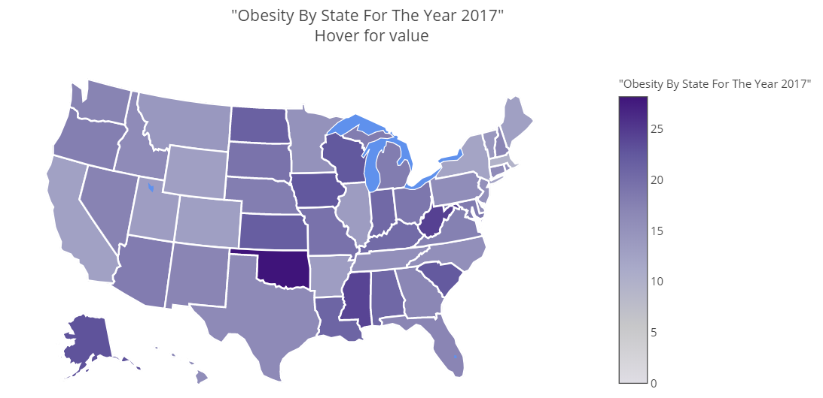
Obesity Percentage by US States for the Year- 2017

Slide 6
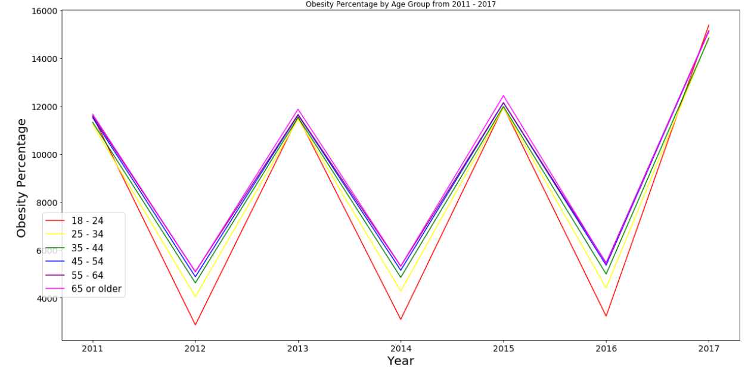
Time series plot that shows Obesity Percentage by Age Group from 2011-2017

Slide 7
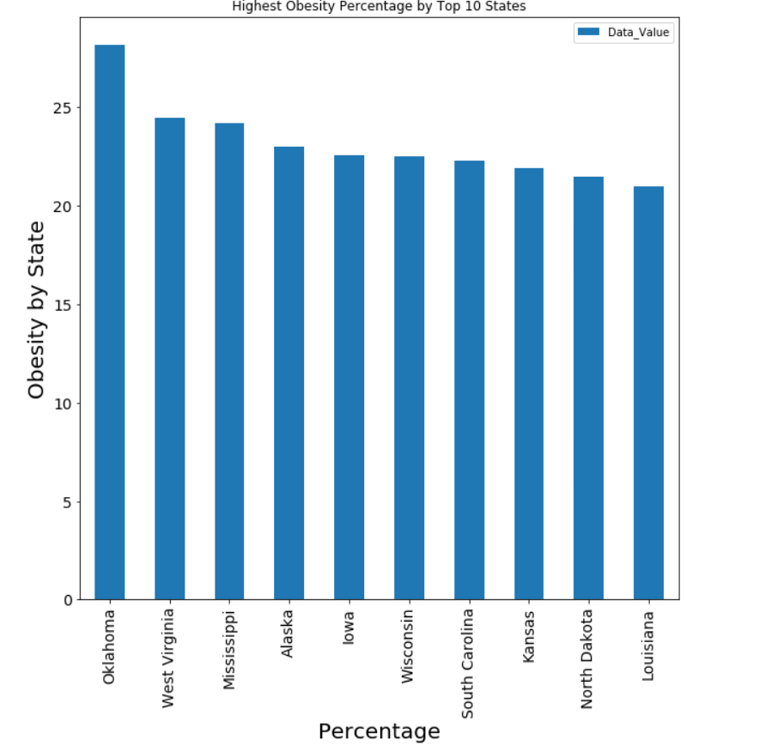
Bar Diagram Showing Obesity Percentage of Top States for the Year 2017.

Slide 8
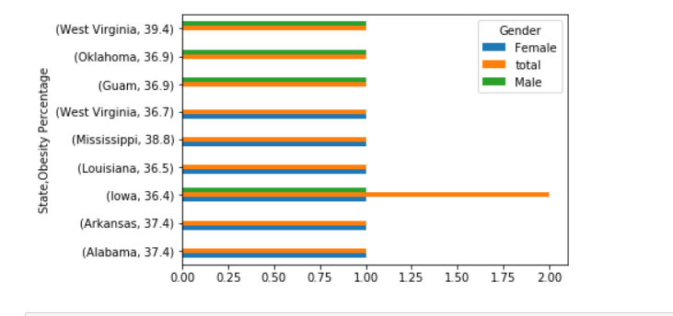
Obesity Percentage by Gender for Top 10 States

Slide 9
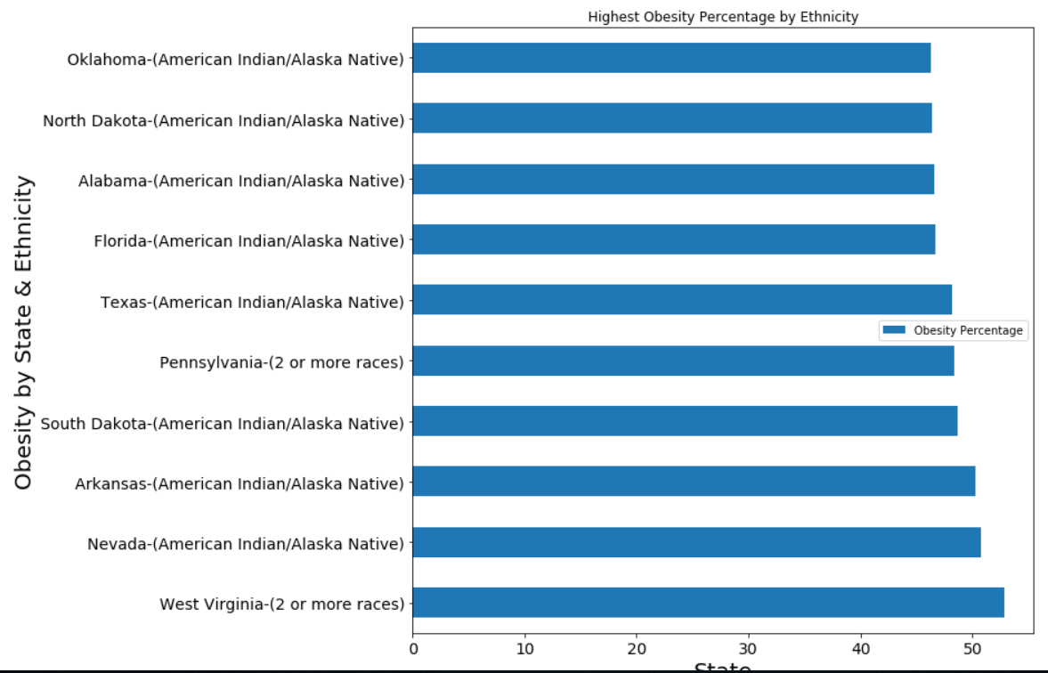
Bar Diagram Showing Obesity Percentage by Ethnicity, in the year 2017

Slide 10
Conclusion
Obesity Percentage by State for Year 2017 | Obesity Percentage by Gender for Year 2017 | Obesity Percentage by Ethnicity for Year 2017 | Obesity Percentage by Age for Year 2011 – 2017 & By Education
Among All states in US, Oklahoma seems to have highest obesity rate and Massachusetts seems to have least obese percentage Among top 10 states with obesity rate, Oklahoma seems to be highest with 28.2 percentage, followed by West Virginia 24.5 percentage and Louisiana has least obesity rate among top 10 for the year 2017 | Among top 10 States by gender, West Virginia seems to be have high obesity rate with 39.4 percentage in male as compare to female Iowa state has least and equal obesity rate of 36.4 in male and female Overall WV, OK, GU & IA has highest male obesity rate MS, AR, WS & IA has highest Female obesity rate | Among top 10 states West Virginia with 52.8 has highest 2 or more races followed by Nevada with American Indian/Alaska Native ethnicity with 50.8 percentage Oklahoma has least percentage of 46.3 with American Indian/Alaska Native ethnicity | Age group 18-24 obesity has gone slightly down, but older age group(35-44 and 45-54) are high in obese Seems like College graduates are obese, followed by Technical school in 2016, but in 2017 High school graduates seems to obese than other levels of education

Slide 11
So who is Obese?
While youth age 18-24 obesity has gone slightly down as compared to other above age groups
But what about the future?
Because the higher values have been so tightly coupled to this graph, they make prediction useless

Slide 12
Thank You

